Slide 1
Software Engineering Week 4
Requirements and Requirements Specification.

Slide 2
Topics covered
Functional and non-functional requirements

Slide 3
What is a requirement?
It may range from a high-level abstract statement of a service or of a system constraint to a detailed mathematical functional specification.

Slide 4
Types of requirement
User requirements
Statements in natural language plus diagrams of the services the system provides and its operational constraints. Written for customers.
System requirements
A structured document setting out detailed descriptions of the system’s functions, services and operational constraints. Defines what should be implemented so may be part of a contract between client and contractor.

Slide 5
User and system requirements

Slide 6
Readers of different types of requirements specification

Slide 7
System stakeholders
Any person or organization who is affected by the system in some way and so who has a legitimate interest
Stakeholder types
End users
System managers
System owners
External stakeholders

Slide 8
Stakeholders in the Mentcare system
Patients whose information is recorded in the system.
Doctors who are responsible for assessing and treating patients.
Nurses who coordinate the consultations with doctors and administer some treatments.
Medical receptionists who manage patients’ appointments.
IT staff who are responsible for installing and maintaining the system.

Slide 9
Stakeholders in the Mentcare system
A medical ethics manager who must ensure that the system meets current ethical guidelines for patient care.
Health care managers who obtain management information from the system.
Medical records staff who are responsible for ensuring that system information can be maintained and preserved, and that record keeping procedures have been properly implemented.

Slide 10
Agile methods and requirements
Many agile methods argue that producing detailed system requirements is a waste of time as requirements change so quickly.
The requirements document is therefore always out of date.
Agile methods usually use incremental requirements engineering and may express requirements as ‘user stories’ (discussed in Chapter 3).
This is practical for business systems but problematic for systems that require pre-delivery analysis (e.g. critical systems) or systems developed by several teams.

Slide 11
Functional and non-functional requirements

Slide 12
Functional and non-functional requirements
Functional requirements
Statements of services the system should provide, how the system should react to particular inputs and how the system should behave in particular situations.
May state what the system should not do.
Non-functional requirements
Constraints on the services or functions offered by the system such as timing constraints, constraints on the development process, standards, etc.
Often apply to the system as a whole rather than individual features or services.
Domain requirements
Constraints on the system from the domain of operation

Slide 13
Functional requirements
Describe functionality or system services.
Depend on the type of software, expected users and the type of system where the software is used.
Functional user requirements may be high-level statements of what the system should do.
Functional system requirements should describe the system services in detail.

Slide 14
Mentcare system: functional requirements
A user shall be able to search the appointments lists for all clinics.
The system shall generate each day, for each clinic, a list of patients who are expected to attend appointments that day.
Each staff member using the system shall be uniquely identified by his or her 8-digit employee number.

Slide 15
Requirements imprecision
Problems arise when functional requirements are not precisely stated.
Ambiguous requirements may be interpreted in different ways by developers and users.
Consider the term ‘search’ in requirement 1
User intention – search for a patient name across all appointments in all clinics;
Developer interpretation – search for a patient name in an individual clinic. User chooses clinic then search.

Slide 16
Requirements completeness and consistency
In principle, requirements should be both complete and consistent.
Complete
They should include descriptions of all facilities required.
Consistent
There should be no conflicts or contradictions in the descriptions of the system facilities.
In practice, because of system and environmental complexity, it is impossible to produce a complete and consistent requirements document.

Slide 17
Non-functional requirements
These define system properties and constraints e.g. reliability, response time and storage requirements. Constraints are I/O device capability, system representations, etc.
Process requirements may also be specified mandating a particular IDE, programming language or development method.
Non-functional requirements may be more critical than functional requirements. If these are not met, the system may be useless.

Slide 18
Types of nonfunctional requirement

Slide 19
Non-functional requirements implementation
Non-functional requirements may affect the overall architecture of a system rather than the individual components.
For example, to ensure that performance requirements are met, you may have to organize the system to minimize communications between components.
A single non-functional requirement, such as a security requirement, may generate a number of related functional requirements that define system services that are required.
It may also generate requirements that restrict existing requirements.

Slide 20
Non-functional classifications
Product requirements
Requirements which specify that the delivered product must behave in a particular way e.g. execution speed, reliability, etc.
Organisational requirements
Requirements which are a consequence of organisational policies and procedures e.g. process standards used, implementation requirements, etc.
External requirements
Requirements which arise from factors which are external to the system and its development process e.g. interoperability requirements, legislative requirements, etc.

Slide 21
Examples of nonfunctional requirements in the Mentcare system
Product requirement The Mentcare system shall be available to all clinics during normal working hours (Mon–Fri, 0830–17.30). Downtime within normal working hours shall not exceed five seconds in any one day. Organizational requirement Users of the Mentcare system shall authenticate themselves using their health authority identity card. External requirement The system shall implement patient privacy provisions as set out in HStan-03-2006-priv.

Slide 22
Usability requirements
The system should be easy to use by medical staff and should be organized in such a way that user errors are minimized. (Goal)
Medical staff shall be able to use all the system functions after four hours of training. After this training, the average number of errors made by experienced users shall not exceed two per hour of system use. (Testable non-functional requirement)

Slide 23
Metrics for specifying nonfunctional requirements
Property | Measure
Speed | Processed transactions/second User/event response time Screen refresh time
Size | Mbytes Number of ROM chips
Ease of use | Training time Number of help frames
Reliability | Mean time to failure Probability of unavailability Rate of failure occurrence Availability
Robustness | Time to restart after failure Percentage of events causing failure Probability of data corruption on failure
Portability | Percentage of target dependent statements Number of target systems

Slide 24
Documenting Requirements to a Standard

Slide 25
Documentation Elements
A Software Requirement Specification (SRS) document contains both User and System Requirements.
In Agile, the requirement may not be complete for the majority of the lifetime of the project. But SRS needs to be as much comprehensive as possible at any stage.
Requirements are ‘engineered’ using various methods such interviews, one-to-one and group discussions.
Gathered information is documented using various formats/templates:
Personas
Scenarios
User Stories
Features

Slide 26
Requirements document variability
Information in requirements document depends on type of system and the approach to development used.
Systems developed incrementally will, typically, have less detail in the requirements document.
Requirements documents standards have been designed e.g. IEEE standard. These are mostly applicable to the requirements for large systems engineering projects.

Slide 27
The structure of a requirements document
Chapter | Description
Preface | This should define the expected readership of the document and describe its version history, including a rationale for the creation of a new version and a summary of the changes made in each version.
Introduction | This should describe the need for the system. It should briefly describe the system’s functions and explain how it will work with other systems. It should also describe how the system fits into the overall business or strategic objectives of the organization commissioning the software.
Glossary | This should define the technical terms used in the document. You should not make assumptions about the experience or expertise of the reader.
User requirements definition | Here, you describe the services provided for the user. The nonfunctional system requirements should also be described in this section. This description may use natural language, diagrams, or other notations that are understandable to customers. Product and process standards that must be followed should be specified.
System architecture | This chapter should present a high-level overview of the anticipated system architecture, showing the distribution of functions across system modules. Architectural components that are reused should be highlighted.

Slide 28
The structure of a requirements document
Chapter | Description
System requirements specification | This should describe the functional and nonfunctional requirements in more detail. If necessary, further detail may also be added to the nonfunctional requirements. Interfaces to other systems may be defined.
System models | This might include graphical system models showing the relationships between the system components and the system and its environment. Examples of possible models are object models, data-flow models, or semantic data models.
System evolution | This should describe the fundamental assumptions on which the system is based, and any anticipated changes due to hardware evolution, changing user needs, and so on. This section is useful for system designers as it may help them avoid design decisions that would constrain likely future changes to the system.
Appendices | These should provide detailed, specific information that is related to the application being developed; for example, hardware and database descriptions. Hardware requirements define the minimal and optimal configurations for the system. Database requirements define the logical organization of the data used by the system and the relationships between data.
Index | Several indexes to the document may be included. As well as a normal alphabetic index, there may be an index of diagrams, an index of functions, and so on.

Slide 29
Requirements and design
In principle, requirements should state what the system should do and the design should describe how it does this.
In practice, requirements and design are inseparable
A system architecture may be designed to structure the requirements;
The system may inter-operate with other systems that generate design requirements;
The use of a specific architecture to satisfy non-functional requirements may be a domain requirement.
This may be the consequence of a regulatory requirement.

Slide 30
Natural language specification
Requirements are written as natural language sentences supplemented by diagrams and tables.
Used for writing requirements because it is expressive, intuitive and universal. This means that the requirements can be understood by users and customers.

Slide 31
Guidelines for writing requirements
Invent a standard format and use it for all requirements.
Use language in a consistent way. Use shall for mandatory requirements, should for desirable requirements.
Use text highlighting to identify key parts of the requirement.
Avoid the use of computer jargon.
Include an explanation (rationale) of why a requirement is necessary.

Slide 32
Problems with natural language
Lack of clarity
Precision is difficult without making the document difficult to read.
Requirements confusion
Functional and non-functional requirements tend to be mixed-up.
Requirements amalgamation
Several different requirements may be expressed together.

Slide 33
Example requirements for the insulin pump software system
3.2 The system shall measure the blood sugar and deliver insulin, if required, every 10 minutes. (Changes in blood sugar are relatively slow so more frequent measurement is unnecessary; less frequent measurement could lead to unnecessarily high sugar levels.) 3.6 The system shall run a self-test routine every minute with the conditions to be tested and the associated actions defined in Table 1. (A self-test routine can discover hardware and software problems and alert the user to the fact the normal operation may be impossible.)

Slide 34
Structured specifications
An approach to writing requirements where the freedom of the requirements writer is limited and requirements are written in a standard way.
This works well for some types of requirements e.g. requirements for embedded control system but is sometimes too rigid for writing business system requirements.

Slide 35
Form-based specifications
Definition of the function or entity.
Description of inputs and where they come from.
Description of outputs and where they go to.
Information about the information needed for the computation and other entities used.
Description of the action to be taken.
Pre and post conditions (if appropriate).
The side effects (if any) of the function.

Slide 36
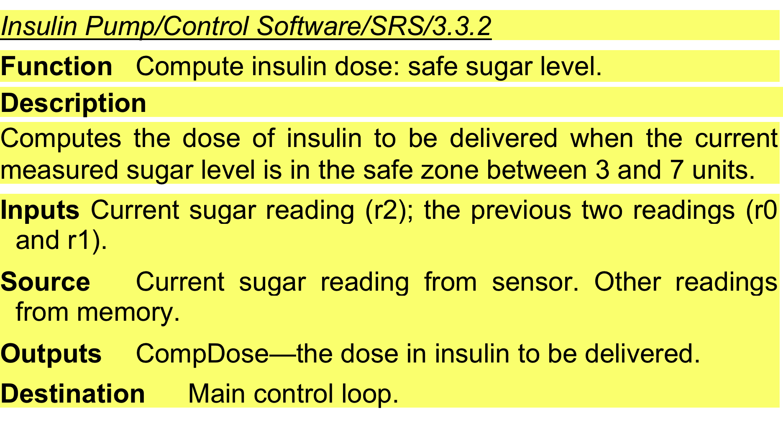
A structured specification of a requirement for an insulin pump

Slide 37
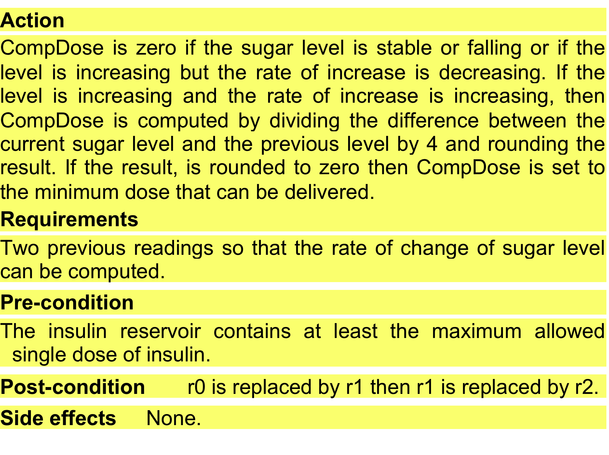
A structured specification of a requirement for an insulin pump

Slide 38
Tabular specification
Used to supplement natural language.
Particularly useful when you have to define a number of possible alternative courses of action.
For example, the insulin pump systems bases its computations on the rate of change of blood sugar level and the tabular specification explains how to calculate the insulin requirement for different scenarios.

Slide 39
Tabular specification of computation for an insulin pump
Condition | Action
Sugar level falling (r2 < r1) | CompDose = 0
Sugar level stable (r2 = r1) | CompDose = 0
Sugar level increasing and rate of increase decreasing ((r2 – r1) < (r1 – r0)) | CompDose = 0
Sugar level increasing and rate of increase stable or increasing ((r2 – r1) ≥ (r1 – r0)) | CompDose = round ((r2 – r1)/4) If rounded result = 0 then CompDose = MinimumDose

Slide 40
Personas
Personas are used to build an understanding of potential users to design features that they are likely to find useful and to design a user interface that is suited to them.
Personas are ‘imagined users’ where you create a character portrait of a type of user that you think might use your product.
For example, if your product is aimed at managing appointments for dentists, you might create a dentist persona, a receptionist persona and a patient persona.
Personas of different types of user help you imagine what these users may want to do with your software and how it might be used.

Slide 41
Personas Description
A persona should ‘paint a picture’ of a type of product user. They should be relatively short and easy-to-read.
You should describe their background and why they might want to use your product.
You should also say something about their educational background and technical skills.
These help you assess whether or not a software feature is likely to be useful, understandable and usable by typical product users

Slide 42
Personas Description

Slide 43
Persona (Example)
Jack, a primary school teacher
Jack, age 32, is a primary school (elementary school) teacher in Ullapool, a large coastal village in the Scottish Highlands. He teaches children from ages 9-12. He was born in a fishing community north of Ullapool, where his father runs a marine fuels supply business and his mother is a community nurse. He has a degree in English from Glasgow University and retrained as a teacher after several years working as a web content author for a large leisure group.
Jack’s experience as a web developer means that he is confident in all aspects of digital technology. He passionately believes that the effective use of digital technologies, blended with face to face teaching, can enhance the learning experience for children. He is particularly interested in using the iLearn system for project-based teaching, where students work together across subject areas on a challenging topic.

Slide 44
Scenarios and User Stories
People find it easier to relate to real-life examples than abstract descriptions. They are not good at telling you the system requirements. However, they may be able to describe how they handle particular situations or imagine things that they might do in a new way of working.
Stories and scenarios are ways of capturing this kind of information.

Slide 45
Scenario
A scenario is a narrative that describes how a user, or a group of users, might use your system.
There is no need to include everything in a scenario – the scenario isn’t a system specification.
It is simply a description of a situation where a user is using your product’s features to do something that they want to do.
Scenario descriptions may vary in length from two to three paragraphs up to a page of text.

Slide 46
Scenarios Description

Slide 47
Scenarios (Example)
Fishing in Ullapool Jack is a primary school teacher in Ullapool, teaching P6 pupils. He has decided that a class project should be focused around the fishing industry in the area, looking at the history, development and economic impact of fishing.
As part of this, students are asked to gather and share reminiscences from relatives, use newspaper archives and collect old photographs related to fishing and fishing communities in the area. Pupils use an iLearn wiki to gather together fishing stories and SCRAN (a history archive site) to access newspaper archives and photographs. However, Jack also needs a photo-sharing site as he wants students to take and comment on each others’ photos and to upload scans of old photographs that they may have in their families. He needs to be able to moderate posts with photos before they are shared, because pre-teen children can’t understand copyright and privacy issues.
Jack sends an email to a primary school teachers’ group to see if anyone can recommend an appropriate system. Two teachers reply and both suggest that he uses KidsTakePics, a photo-sharing site that allows teachers to check and moderate content. As KidsTakePics is not integrated with the iLearn authentication service, he sets up a teacher and a class account with KidsTakePics.
He uses the the iLearn setup service to add KidsTakePics to the services seen by the students in his class so that, when they log in, they can immediately use the system to upload photos from their phones and class computers.

Slide 48
Scenarios (Elements of the Example)
A brief statement of the overall objective.
In Jack’s scenario, this is to support a class project on the fishing industry.
References to the personas involved (Jack) so that you can get information about the capabilities and motivation of that user.
Information about what is involved in doing the activity. For example, in Jack’s scenario this involves gathering reminiscences from relatives, accessing newspaper archives, etc.
An explanation of problems that can’t be readily addressed using the existing system.
Young children don’t understand issues such as copyright and privacy, so photo sharing requires a site that a teacher can moderate to make sure that published images are legal and acceptable.
A description of one way that the identified problem might be addressed.
In Jack’s scenario, the preferred approach is to use an external tool designed for school students.

Slide 49
User Stories
Scenarios are high-level stories of system use. They should describe a sequence of interactions with the system but should not include details of these interactions.
User stories are finer-grain narratives that set out in a more detailed and structured way a single thing that a user wants from a software system.
As an author, I need a way to organize the book that I’m writing into chapters and sections.
This story reflects what has become the standard format of a user story:
As a <role>, I <want | need> to <do something>
As a teacher, I want to tell all members of my group when new information is available

Slide 50
User Stories
An important use of user stories is in planning.
Many users of the Scrum method represent the product backlog as a set of user stories.
User stories should focus on a clearly defined system feature or aspect of a feature that can be implemented within a single sprint.
If the story is about a more complex feature that might take several sprints to implement, then it is called an epic.
As a system manager, I need a way to backup the system and restore either individual applications, files, directories or the whole system.

Slide 51
User Stories (Example)

Slide 52
User Stories
Stories can be used to describe features in your product that should be implemented.
Each feature can have a set of associated stories that describe how that feature is used.

Slide 53
Scenarios vs User Stories
Scenarios read more naturally because they describe what a user of a system is actually doing with that system. People often find it easier to relate to this specific information rather than the statement of wants or needs set out in a set of user stories.
If you are interviewing real users or are checking a scenario with real users, they don’t talk in the stylized way that is used in user stories. People relate better to the more natural narrative in scenarios.
In some situation, scenarios can provide more context that user stories.

Slide 54
Features
A feature is a way of allowing users to access and use your product’s functionality so the feature list defines the overall functionality of the system.
Features should be independent, coherent and relevant:
Independence Features should not depend on how other system features are implemented.
Coherence Features should be linked to a single item of functionality..
Relevance Features should reflect the way that users normally carry out some task.

Slide 55
Knowledge Required for Feature Design

Slide 56
Knowledge Required for Feature Design
User knowledge You can use user scenarios and user stories to inform the team of what users want and how they might use it the software features.
Product knowledge You may have experience of existing products or decide to research what these products do as part of your development process. Sometimes, your features have to replicate existing features in these products because they provide fundamental functionality that is always required.
Domain knowledge This is knowledge of the domain or work area(e.g. finance, event booking) that your product aims to support. By understanding the domain, you can think of new innovative ways of helping users do what they want to do.
Technology knowledge New products often emerge to take advantage of technological developments since their competitors were launched. If you understand the latest technology, you can design features to make use of it.

Slide 57
Factors in Feature Design

Slide 58
Feature Tradeoff and Creep
Simplicity and functionality
There should be balance between providing a simple, easy-to-use system and including enough functionality to attract users with a variety of needs.
Familiarity and novelty
Users prefer that new software should support the familiar everyday tasks that are part of their work or life. There should be a balance between familiar features and new features.
Automation and control
There need to be a balance between automation and manual tasks. The system should be tailored to the customers needs.
Feature Creep
Feature creep occurs when new features are added in response to user requests without considering if these features are generally useful or can be implemented in some other way.

Slide 59
Features Identification
Features can be identified directly from the product vision or from scenarios.
You should think about the features needed to support user actions, identified by active verbs, such as use and choose.
Features in Jack’s Scenario:
A wiki for group writing.
Access to the SCRAN history archive. This is a shared national resource that provides access to historical newspaper and magazine articles for schools and universities.
Features to set up and access an email group.
A feature to integrate applications with the iLearn authentication service.

Slide 60
Feature List
The output of the feature identification process should be a list of features that you use for designing and implementing in the software.
You can describe features using a standard input-action-output template by using scenarios and user stories.
Scenarios tell you how users work at the moment. They don’t show how they might change their way of working if they had the right software to support them.
Stories and scenarios are ‘tools for thinking’ and they help you gain an understanding of how your software might be used. You can identify a feature set from stories and scenarios.

